Slide 1

MIMIC Inception
Team 10
David Restrepo
Suraj Shourie
Sabine Friedrich, MD, MS
Amy L. Dzierba, PharmD
Patrick M. Wieruszewski, PharmD
Samar Mehta, MD, PhD
Adham Mohamed, PharmD

Slide 2
Background
Inequalities in quality of care lead to negative patient outcomes
Pain, agitation, and delirium management
Pain management disparities have been reported across racial and ethnic groups
Black patients undergoing emergency psychiatric evaluation were more likely to receive chemical restraint
Circulation. 2020;142:e454-e468.
Crit Care Med. 2018;46:e825-e873.
PS. 2022;73:730-736.
Annals of Epidemiology. 2022;69:9-16.
JAMA Netw Open. 2022;5:e2216281.
Pain Manag. 2019;9:317-334.
Notes:
Delayed or inadequate treatment, health disparities, under or misdiagnosis, limited access to advanced therapies, chronic disease management, mental health
Unknown if this inequalities in pain or sedation management lead to negative patient outcomes

Slide 3

Are there differences in sedative agent selection in adult patients on invasive mechanical ventilation based on race

Slide 4
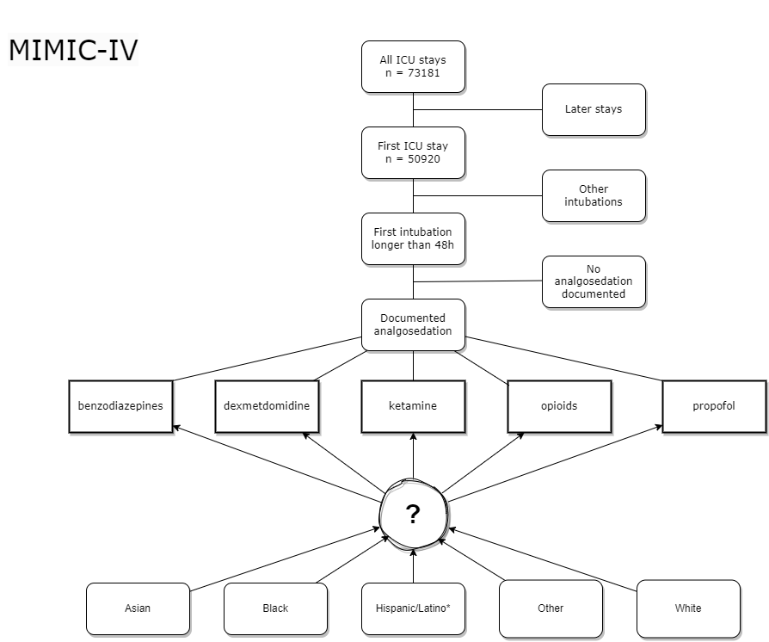
Methods

Slide 5
Baseline
Characteristics
n=7114
Age, years | 62±16.4
Gender, male | 4126 (58.0)
Weight, kg | 83.9±29.4
Race White Black HIspanic/Latino Asian Other | 4430 (62.3) 712 (10.0) 243 (3.4) 187 (2.6) 1542 (21.6)
Intensive care unit MICU SICU TSICU MICU/SICU CVICU CCU Neuro SICU Neuro Intermediate Neuro Stepdown | 1745 (24.5) 1330 (18.7) 1296 (18.2) 1083 (15.2) 846 (11.9) 637 (9.0) 164 (2.3) 9 (0.1) 4 (0.1)
Insurance Medicare Medicaid Other | 3200 (45.0) 634 (8.9) 3280 (46.1)
English language | 6344 (89.2)
All data presented as mean±SD or n (%)

Slide 6
Opioids
 | Entire cohort n=7114 | White n=4430 | Black n=712 | Hispanic/ Latino n=243 | Asian n=187 | Other n=1542
Opioids, n (%) | 1719 (24.2) | 1142 (25.8) | 134 (18.8) | 53 (21.9) | 48 (25.7) | 342 (22.2)
Unadjusted OR (95% CI) | - | 1.00 | 0.67 (0.55-0.81) | 0.81 (0.59-1.10) | 1.00 (0.71-1.38) | 0.82 (0.72-0.94)
Adjusted OR (95% CI)* | - | 1.00 | 0.56 (0.45-0.69) | 0.91 (0.65-1.26) | 0.91 (0.63-1.29) | 1.09 (0.94-1.27)
*Multivariable logistic regression:
age, gender, care unit, insurance, mechanical ventilation duration, year (2011-13, 2014-16, 2017-19)

Slide 7
Sedatives
 | Entire cohort n=7114 | White n=4430 | Black n=712 | Hispanic/ Latino n=243 | Asian n=187 | Other n=1542
Propofol | 6090 (85.6) | 3786 (85.4) | 589 (82.7) | 220 (90.9) | 149 (79.7) | 1346 (87.4)
Unadjusted OR (95% CI) |  | 1.00 | 0.82 (0.66-1.01) | 1.71 (1.12-2.74) | 0.67 (0.47-0.98) | 1.19 (1.00-1.41)
Adjusted OR (95% CI) |  | 1.00 | 0.95 (0.76-1.20) | 1.42 (0.90-2.34 | 0.69 (0.46-1.04) | 0.76 (0.62-0.92)
Dexmedetomidine | 2369 (33.3) | 1444 (32.6) | 211 (29.6) | 90 (37.2) | 51 (27.3) | 573 (37.2)
Unadjusted OR (95% CI) |  | 1.00 | 0.87 (0.73-1.03) | 1.23 (0.93-1.60) | 0.78 (0.55-1.07) | 1.23 (1.09-1.38)
Adjusted OR (95% CI) |  | 1.00 | 0.94 (0.78-1.13) | 0.99 (0.74-1.32) | 0.78 (0.54-1.10) | 0.76 (0.66-0.87)
Benzodiazepines | 3427 (48.2) | 2145 (58.4) | 365 (51.3) | 104 (43.0) | 102 (54.6) | 711 (46.2)
Unadjusted OR (95% CI) |  | 1.00 | 1.12 (0.96-1.31) | 0.80 (0.62-1.04) | 1.28 (0.95-1.72) | 0.91 (0.81-1.03)
Adjusted OR (95% CI) |  | 1.00 | 0.95 (0.79-1.13) | 0.79 (0.59-1.06) | 1.34 (0.97-1.86 | 1.18 (1.03-1.34)
Multivariable logistic regression: age, gender, care unit, insurance, mechanical ventilation duration, year

Slide 8
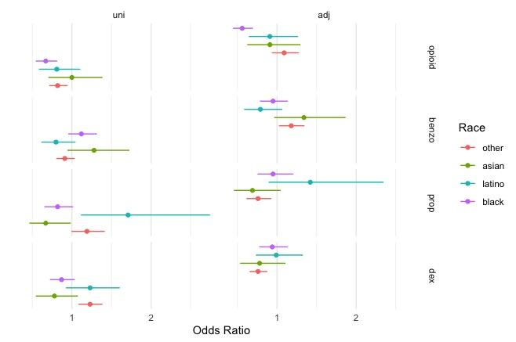

Slide 9
Causal Inference Approach
Causal Effect Estimation
Model
P(Y|T=0)
P(Y|T=1)
White
Black

Slide 10
Causal Inference Approach
Causal Effect Estimation
Model
P(Y|T=0)
P(Y|T=1)
White
Black

Slide 11
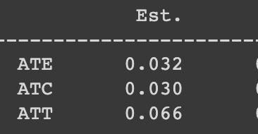
Results:
ATE = 1/n * P(Y|T=0) - P(Y|T=1)
Hispanic
Treatment | Hispanic (Yes/No)
Cofounders | Gender, Language, Insurance
Outcome | Propofol (Yes/No)
ATE (Average Treatment Effect)
ATC (Average Treatment Effect on the Treated)
ATT (Average Treatment Effect on the Untreated)

Slide 12
Limitations / Future Directions
MIMIC IV database from 2008-2019 (changes in sedation practices over time)
Doses may have differed / different sedation practices protocols
Control for patient characteristics (e.g., substance abuse)
Pain and depth of sedation
Confounders: severity of illness, reason for mechanical ventilation
Patient centered outcomes

